Slide 1
Wireless Application Protocol
Sridhar Iyer
KR School of Information Technology
IIT Bombay
http://www.it.iitb.ernet.in/~sri
Jan 2001

Slide 2
Outline
Mobile applications
How are mobile/wireless environments different?
What is WAP?
WAP Architecture
WAE (WML/WMLScript)
WTA Framework
WAP Push Services
WAP Protocol Stack
Hype v/s Reality
References and Resources

Slide 3
Mobile Applications - 1
Vehicles
  transmission of news, road condition etc
  ad-hoc network with near vehicles to prevent accidents
Emergencies
  early transmission of patient data to the hospital
  ad-hoc network in case of earthquakes, cyclones
  military ...
Traveling salesmen
  direct access to central customer files
  consistent databases for all agents
  mobile office

Slide 4
Mobile Applications - 2
Web access
  outdoor Internet access
  intelligent travel guide with up-to-date location dependent information
Information services
  push: stock quotes; pull: nearest cash ATM
Disconnected operations
  file-system caching for off-line work
  mobile agents, e.g., shopping
Entertainment
  games, etc

Slide 5
Variability of the Mobile Environment
Mobility
stationary
nomadic (pedestrian speed)
mobile (vehicular speed)
roaming (mobile across networks)
Connectivity
connected
semi-connected
(asymmetric)
weakly connected
disconnected
Mobile Device Capability
form factor
GUI
multimedia
real-time multimedia

Slide 6
World Wide Web and Mobility
HTTP/HTML have not been designed for mobile applications/devices
HTTP 1.0 characteristics
  designed for large bandwidth, low delay
  stateless, client/server, request/response communication
  connection oriented, one connection per request
  TCP 3-way handshake, DNS lookup overheads
  big protocol headers, uncompressed content transfer
  primitive caching (often disabled, dynamic objects)
  security problems (using SSL/TLS with proxies)
HTML characteristics
  designed for computers with “high” performance, color high-resolution display, mouse, hard disk
  typically, web pages optimized for design, not for communication; ignore end-system characteristics

Slide 7
System Support for Mobile WWW
Enhanced browsers
  client-aware support for mobility
Proxies
  Client proxy: pre-fetching, caching, off-line use
  Network proxy: adaptive content transformation for connections
  Client and network proxy
Enhanced servers
  server-aware support for mobility
  serve the content in multiple ways, depending on client capabilities
New protocols/languages
  WAP/WML

Slide 8
Wireless Application Protocol (WAP)
Empowers mobile users with wireless devices to easily access and interact with information and services.
A “standard” created by wireless and Internet companies to enable Internet access from a cellular phone
wapforum.org:
  co-founded by Ericsson, Motorola, Nokia, Phone.com
  450 members in 2000, comprise of Handset manufacturers, Wireless service providers, ISPs, Software companies in the wireless industry
  Goals
    deliver Internet services to mobile devices
    enable applications to scale across a variety of transport options and device types
    independence from wireless network standards
    GSM, CDMA IS-95, TDMA IS-136, 3G systems (UMTS, W-CDMA)

Slide 9
WAP: Main Features
Browser
  “Micro browser”, similar to existing web browsers
Markup language
  Similar to HTML, adapted to mobile devices
Script language
  Similar to Javascript, adapted to mobile devices
Gateway
  Transition from wireless to wired world
Server
  “Wap/Origin server”, similar to existing web servers
Protocol layers
  Transport layer, security layer, session layer etc.
Telephony application interface
  Access to telephony functions

Slide 10
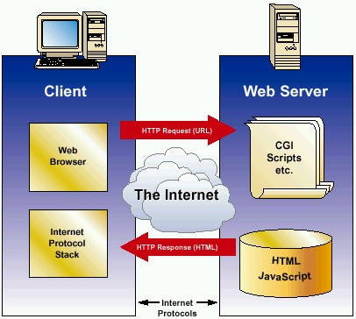
Internet Model
HTML
HTTP
TLS/SSL
TCP/IP

Slide 11

WAP Architecture
Client
Web Server
WAP Gateway
WML
CGI
Scripts
etc.
WML Encoder
WML-Script
WSP/WTP
HTTP
WML Decks
with WML-Script
WMLScript
Compiler
WTAI
Protocol Adapters
Content
Etc.
Source: WAP Forum

Slide 12
WAP Application Server
Client
WAP Application Server
WML
WML Encoder
Application
Logic
WML-Script
WSP/WTP
WMLScript
Compiler
WML Decks
with WML-Script
WTAI
Protocol Adapters
Content
Etc.
Source: WAP Forum

Slide 13
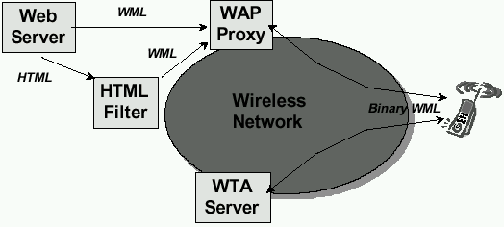
WAP Architecture
Another look
Key Components
Origin/Web Server
WAP Gateway/Proxy
WAP Protocol Stack
Micro Browser
WML/WML Script
Transcoders
WTA
Source: WAP Forum

Slide 14
WAP: Network Elements
fixed network
wireless network
Internet
WML
WAP
proxy
Binary WML
HTML
filter
HTML
WML
HTML
filter/
WAP
proxy
Binary WML
web
server
HTML
WTA
server
Binary WML
PSTN
Binary WML: binary file format for clients
Source: Schiller

Slide 15
WAP Specifies
Wireless Application Environment
  WML Microbrowser
  WMLScript Virtual Machine
  WMLScript Standard Library
  Wireless Telephony Application Interface (WTAI)
  WAP content types
Wireless Protocol Stack
  Wireless Session Protocol (WSP)
  Wireless Transport Layer Security (WTLS)
  Wireless Transaction Protocol (WTP)
  Wireless Datagram Protocol (WDP)
  Wireless network interface definitions

Slide 16
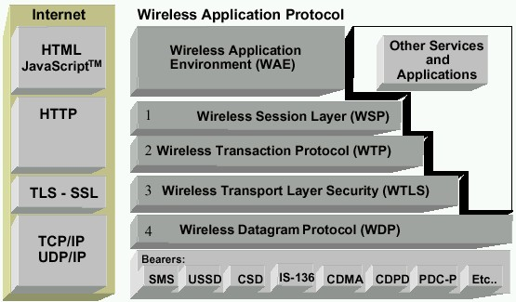
WAP Stack
Runs on top of WDP
Provided lightweight X-oriented service
Unreliable 1-way request
Reliable 1-way/2-way req./response
MicroBrowser (WML, WMLScript, WTA, WTAI)
Lightweight SSL
Uses WIM/PKI-Cards
Datagram service on different bearers
Convergence between bearer services
Different Wireless Tech.
Source: WAP Forum

Slide 17
WAP Stack
WAE (Wireless Application Environment):
  Architecture: application model, browser, gateway, server
  WML: XML-Syntax, based on card stacks, variables, ...
  WTA: telephone services, such as call control, phone book etc.
WSP (Wireless Session Protocol):
  Provides HTTP 1.1 functionality
  Supports session management, security, etc.
WTP (Wireless Transaction Protocol):
  Provides reliable message transfer mechanisms
  Based on ideas from TCP/RPC
WTLS (Wireless Transport Layer Security):
  Provides data integrity, privacy, authentication functions
  Based on ideas from TLS/SSL
WDP (Wireless Datagram Protocol):
  Provides transport layer functions
  Based on ideas from UDP
Content encoding, optimized for low-bandwidth channels, simple devices

Slide 18
WHY WAP?
Wireless networks and phones
  have specific needs and requirements
  not addressed by existing Internet technologies
WAP
  Enables any data transport
    TCP/IP, UDP/IP, GUTS (IS-135/6), SMS, or USSD.
  Optimizes the content and air-link protocols
  Utilizes plain Web HTTP 1.1 servers
    leverages existing development methodologies
    utilizes standard Internet markup language technology (XML)
    all WML content is accessed via HTTP 1.1 requests
  WML UI components map well onto existing mobile phone user interfaces
    no re-education of the end-users
    leveraging market penetration of mobile devices
  Several modular entities together form a fully compliant Internet entity

Slide 19
Why is HTTP/HTML not enough?
Big pipe - small pipe syndrome
Internet
Wireless network
HTTP/HTML
WAP
<HTML>
<HEAD>
<TITLE>NNN Interactive</TITLE>
<META HTTP-EQUIV="Refresh" CONTENT="1800, URL=/index.html">
</HEAD>
<BODY BGCOLOR="#FFFFFF" BACKGROUND="/images/9607/bgbar5.gif" LINK="#0A3990" ALINK="#FF0000" VLINK="#FF0000" TEXT="000000" ONLOAD="if(parent.frames.length!=0)top.location='http://nnn.com';">
<A NAME="#top"></A>
<TABLE WIDTH=599 BORDER="0">
<TR ALIGN=LEFT>
<TD WIDTH=117 VALIGN=TOP ALIGN=LEFT>
<WML>
<CARD>
<DO TYPE="ACCEPT">
<GO URL="/submit?Name=$N"/>
</DO>
Enter name:
<INPUT TYPE="TEXT" KEY="N"/>
</CARD>
</WML>
Content encoding
<HTML>
<HEAD>
<TITLE>NNN Interactive</TITLE>
<META HTTP-EQUIV="Refresh" CONTENT="1800, URL=/index.html">
010011010011110110010011011011011101010010011010
Source: WAP Forum

Slide 20
WAP: “Killer” Applications
Location-based services
  Real-time traffic reporting, Event/restaurant recommendation
Enterprise solutions
  Email access, Database access, “global” intranet access
  Information updates “pushed” to WAP devices
Financial services
  Banking, Bill-paying, Stock trading, Funds transfers
Travel services
  Schedules and rescheduling, Reservations
Gaming and Entertainment
  Online, real-time, multi-player games
  Downloadable horoscopes, cartoons, quotes, advice
M-Commerce
  Shopping on the go
  Instant comparison shopping
  Location-based special offers and sales

Slide 21
Wireless Application Environment (WAE)
Goals
  device and network independent application environment
  for low-bandwidth, wireless devices
  considerations of slow links, limited memory, low computing power, small display, simple user interface (compared to desktops)
  integrated Internet/WWW programming model
  high interoperability

Slide 22
WAE Components
Architecture
  Application model, Microbrowser, Gateway, Server
User Agents
  WML/WTA/Others
  content formats: vCard, vCalendar, Wireless Bitmap, WML, ...
WML
  XML-Syntax, based on card stacks, variables, ...
WMLScript
  procedural, loops, conditions, ... (similar to JavaScript)
WTA
  telephone services, such as call control, text messages, phone book, ... (accessible from WML/WMLScript)
Proxy (Method/Push)

Slide 23
WAE: Logical Model
Origin Servers
Gateway
Client
Method proxy
WTA
user agent
web
server
response
with
content
encoded
response
with
content
Push proxy
WML
user agent
other content
server
push
content
encoded
push
content
encoders
&
decoders
other
WAE
user agents
request
encoded
request

Slide 24
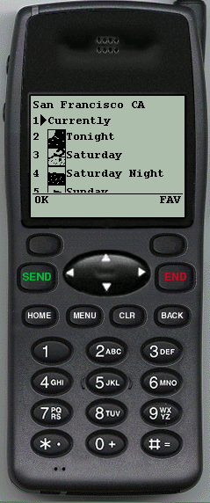
WAP Microbrowser
Optimized for wireless devices
Minimal RAM, ROM, Display, CPU and keys
Provides consistent service UI across devices
Provides Internet compatibility
Enables wide array of available content and applications

Slide 25




WML: Wireless Markup Language
Tag-based browsing language:
  Screen management (text, images)
  Data input (text, selection lists, etc.)
  Hyperlinks & navigation support
Takes into account limited display, navigation capabilities of devices
XML-based language
  describes only intent of interaction in an abstract manner
  presentation depends upon device capabilities
Cards and Decks
  document consists of many cards
  User interactions are split into cards
  Explicit navigation between cards
  cards are grouped to decks
  deck is similar to HTML page, unit of content transmission
Events, variables and state mgmt
Content (XML)
XSL Processor
WML Stylesheet
HTML StyleSheet
WML Browsers
HTTP Browser

Slide 26
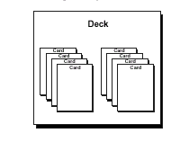
WML
The basic unit is a card. Cards are grouped together into Decks Document ~ Deck (unit of transfer)
All decks must contain
  Document prologue
    XML & document type declaration
  <WML> element
    Must contain one or more cards
WML File Structure
<?xml version="1.0"?>
<!DOCTYPE WML PUBLIC "-//WAPFORUM//DTD WML 1.0//EN"
"http://www.wapforum.org/DTD/wml.xml">
<WML>
...
</WML>

Slide 27
WML Example
<WML>
<CARD>
<DO TYPE=“ACCEPT”>
<GO URL=“#eCard”/>
</DO
Welcome!
</CARD>
<CARD NAME=“eCard”>
<DO TYPE=“ACCEPT”>
<GO URL=“/submit?N=$(N)&S=$(S)”/>
</DO>
Enter name: <INPUT KEY=“N”/>
Choose speed:
<SELECT KEY=“S”>
<OPTION VALUE=“0”>Fast</OPTION>
<OPTION VALUE=“1”>Slow</OPTION>
<SELECT>
</CARD>
</WML>
Navigation
Card
Variables
Deck
Input
Elements

Slide 28
A Deck of Cards
<WML>
<CARD>
<DO TYPE="ACCEPT" LABEL="Next">
<GO URL="#card2"/>
</DO>
Acme Inc.<BR/>Directory
</CARD>
<CARD NAME="card2">
<DO TYPE="ACCEPT">
<GO URL="?send=$type"/>
</DO>
Services
<SELECT KEY="type">
<OPTION VALUE="em">Email</OPTION>
<OPTION VALUE="ph">Phone</OPTION>
<OPTION VALUE="fx">Fax</OPTION>
</SELECT>
</CARD>
</WML>
Acme Inc.
Directory
_____________
Next
Services
1>Email
2 Phone
____________
OK
Source: WAP Forum

Slide 29
The DO Element
Binds a task to a user action
  Action type: ACCEPT, OPTIONS, HELP
  PREV, DELETE, RESET
  Label: Text string or image (optional)
  Task: GO
  PREV, REFRESH, NOOP
  Destination: URL
  Post data: if METHOD=POST
<DO TYPE="ACCEPT" LABEL="Next">
<GO URL="http://www.mysite.com/myapp.wml"/>
</DO>
Source: WAP Forum

Slide 30
Anchored Links
Bind a task to the ACCEPT action,
when cursor points to a link
  TITLE= sets the label string (default = “Link”)
  Links are not allowed in select list options
<CARD>
Please visit our
<A TITLE="Visit">
<GO URL="home.wml"/>home page</A>
for details.
</CARD>
Please visit
our home
page for
____________
Visit
Source: WAP Forum

Slide 31
The TEMPLATE Element
Defines actions & events for all cards in a deck
<WML>
<TEMPLATE>
<DO TYPE="OPTIONS" LABEL="Main">
<GO URL="main_menu.wml"/>
</DO>
</TEMPLATE>
<CARD NAME="msg1">
<DO TYPE="ACCEPT" LABEL="Next">
<GO URL="#msg2"/>
</DO>
First story
</CARD>
<CARD NAME="msg2">
Second story
</CARD>
</WML>
First story
…
_____________
Next Main
Second story
...
_____________
OK Main
Source: WAP Forum

Slide 32
Handling User Input
Select lists
  Choose from a list of options
Input fields
  Enter a string of text or numbers
KEY variables
  Set by SELECT and INPUT elements
  How user input is passed to other cards and the application server
Source: WAP Forum

Slide 33
The SELECT Element
Display a list of options
  Each option may set the KEY variable and/or bind a task to the ACCEPT key
  TITLE= dynamically sets the label string
  MULTIPLE=“TRUE”: Allows user to pick multiple items
<CARD>
<DO TYPE="ACCEPT" LABEL="View">
<GO URL="getcity.cgi?location=$city"/>
</DO>
Forecast
<SELECT KEY="city">
<OPTION VALUE="ber">Berlin</OPTION>
<OPTION VALUE="rom">Rome</OPTION>
<OPTION TITLE="Find" ONCLICK="find.cgi">New City</OPTION>
</SELECT>
</CARD>
Forecast
1 Berlin
2 Rome
3>New City
____________
Find
Source: WAP Forum

Slide 34
The INPUT Element
Prompts user to enter a string of text
  DEFAULT=key_value; Default KEY variable (displayed to user)
  FORMAT=format_specifier; If omitted, free-form entry is allowed
  EMPTYOK="TRUE“; Browser will accept null input
  TYPE="PASSWORD“; Special entry mode handled by the browser
  MAXLENGTH=number; Maximum number of allowed characters
Soc. Security:
287-33- _
____________
NUM
<CARD>
<DO TYPE="ACCEPT">
<GO URL="?get=person"
METHOD="POST" POSTDATA="userid=$ssn"/>
</DO>
Soc Security:
<INPUT KEY="ssn" FORMAT="NNN\-NN\-NNNN"/>
</CARD>
Soc. Security:
287-33- 7629
____________
OK
Source: WAP Forum

Slide 35
WML Content Formats
Common interchange formats, for interoperability
Formats:
  Business cards: IMC vCard standard
  Calendar: IMC vCalendar standard
  Images: WBMP (Wireless BitMaP)
  Compiled WML, WMLScript
Newly defined formats:
  WML text and tokenized format
  WMLScript text and bytecode format
  WBMP image format
Binary format for size reduction
  Bytecodes/tokens for common values and operators
  Compressed headers
  Data compression (e.g. images)
General-purpose transport compression can still be applied

Slide 36
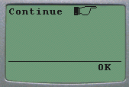
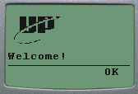
Displaying Images
Insert app images or local icons within display text
  1-bit BMP format
Images are ignored by non-bitmapped devices
  Check HTTP_ACCEPT for “image/bmp”
<CARD>
<DO TYPE="ACCEPT">
<GO URL="#c2"/>
</DO>
Continue <IMG LOCALSRC="righthand"
ALT="forward..."/>
</CARD>
<CARD NAME="c2">
<IMG SRC="../images/logo.wbmp"
ALT="Unwired Planet"/>
<BR/>Welcome!
</CARD>
Source: WAP Forum

Slide 37
WML (other features)
Setting card styles to create forms
Using variables to cache user data
Using card intrinsic events to trigger transparent tasks
Using timers
Securing WML decks
Bookmarking decks

Slide 38
WMLScript
Complement to WML
  Derived from JavaScript™
Provides general scripting capabilities
  Procedural logic, loops, conditionals, etc.
  Optimized for small-memory, small-cpu devices
Features
  local user interaction, validity check of user input
  access to device facilities (phone call, address book etc.)
  extensions to the device software
    configure device, download new functionality after deployment
Bytecode-based virtual machine
  Stack-oriented design, ROM-able
  Designed for simple, low-impact implementation
WMLScript compiler resides in the network

Slide 39
WMLScript Libraries
Lang - VM constants, general-purpose math functionality, etc.
String - string processing functions
URL - URL processing
Browser - WML browser interface
Dialog - simple user interface
Float - floating point functions

Slide 40
WMLScript Example
Functions
function currencyConvertor(currency, exchRate) {
return currency*exchangeRate;
}
function myDay(sunShines) {
var myDay;
if (sunShines) {
myDay = “Good”;
} else {
myDay = “Not so good”;
};
return myDay;
}
Variables
Programming
Constructs
Source: WAP Forum

Slide 41
Wireless Telephony Application (WTA)
Collection of telephony specific extensions
  designed primarily for network operators
Example
  calling a number (WML)
  wtai://wp/mc;07216086415
  calling a number (WMLScript)
  WTAPublic.makeCall("07216086415");
Implementation
  Extension of basic WAE application model
  Extensions added to standard WML/WMLScript browser
  Exposes additional API (WTAI)

Slide 42
WTA Features
Extension of basic WAE application model
  network model for interaction
    client requests to server
    event signaling: server can push content to the client
  event handling
    table indicating how to react on certain events from the network
    client may now be able to handle unknown events
  telephony functions
    some application on the client may access telephony functions
WTAI includes:
  Call control
  Network text messaging
  Phone book interface
  Event processing
Security model: segregation
  Separate WTA browser
  Separate WTA port

Slide 43
WTA Example (WML)
Placing an outgoing call with WTAI:
<WML>
<CARD>
<DO TYPE=“ACCEPT”>
<GO URL=“wtai:cc/mc;$(N)”/>
</DO>
Enter phone number:
<INPUT TYPE=“TEXT” KEY=“N”/>
</CARD>
</WML>
WTAI Call
Input Element
Source: WAP Forum

Slide 44
WTA Example (WMLScript)
Placing an outgoing call with WTAI:
function checkNumber(N) {
if (Lang.isInt(N))
WTAI.makeCall(N);
else
Dialog.alert(“Bad phone number”);
}
WTAI Call
Source: WAP Forum

Slide 45
WTA Logical Architecture
other telephone networks
WTA Origin Server
WML
Scripts
Client
mobile
network
WTA
user agent
WTA & WML
server
WML
decks
WAE
services
WTA
services
WAP Gateway
encoders
&
decoders
network operator
trusted domain
other WTA
servers
third party
origin servers
firewall
Source: Schiller

Slide 46
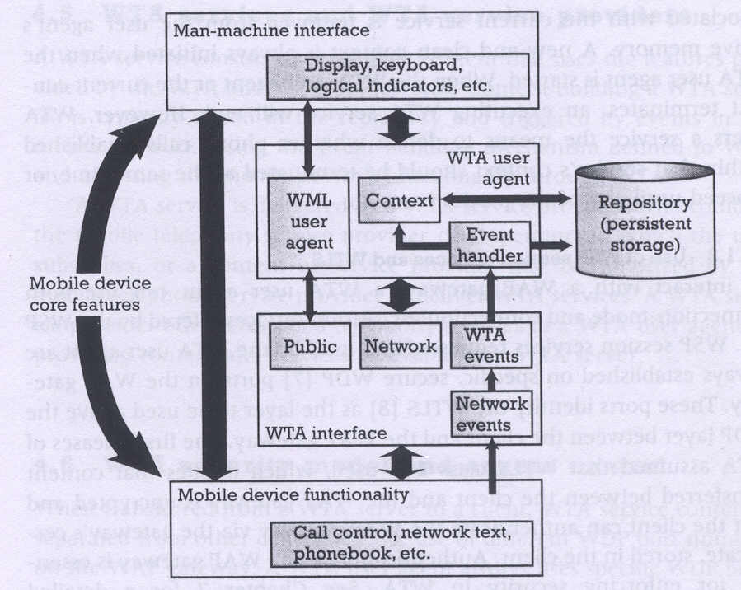
WTA Framework Components
Source: Heijden

Slide 47
WTA User Agent
WTA User Agent
  WML User agent with extended functionality
  can access mobile device’s telephony functions through WTAI
  can store WTA service content persistently in a repository
  handles events originating in the mobile network
WTA User Agent Context
  Abstraction of execution space
  Holds current parameters, navigation history, state of user agent
  Similar to activation record in a process address space
Uses connection-mode and connectionless services offered by WSP
Specific, secure WDP ports on the WAP gateway

Slide 48
WTA Events and Repository
WTA Events
  Network notifies device of event (such as incoming call)
  WTA events map to device’s native events
  WTA services are aware of and able to act on these events
  example: incoming call indication, call cleared, call connected
WTA Repository
  local store for content related to WTA services (minimize network traffic)
  Channels: define the service
    content format defining a WTA service stored in repository
    XML document specifying eventid, title, abstract, and resources that implement a service
  Resources: execution scripts for a service
    could be WML decks, WML Scripts, WBMP images..
    downloaded from WTA server and stored in repository before service is referenced
  Server can also initiate download of a channel

Slide 49
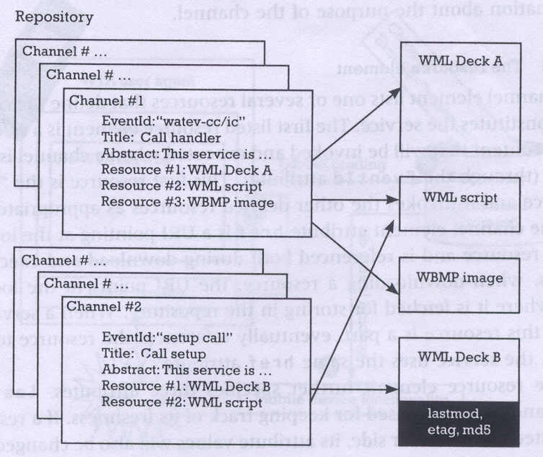
WTA Channels and Resources
Source: Heijden

Slide 50
WTA Interface (public)
WTA Interface
  generic, high-level interface to mobile’s telephony functions
  setting up phone calls, reading and writing entries in phonebook..
Public WTAI
  for third party WML content providers
  restricted set of telephony functions available to any WAE User Agent
  library functions
    make call: allows application to setup call to a valid tel number
    send DTMF tones: send DTMF tones through the setup call
  user notified to grant permission for service execution
  cannot be triggered by network events
  example: Yellow pages service with “make call” feature

Slide 51
WTA Interface (network)
Network Common WTAI
  WTA service provider is in operator’s domain
  all WTAI features are accessible, including the interface to WTA events
  library functions
    Voice-call control: setup call, accept, release, send DTMF tones
    Network text: send text, read text, remove text (SMS)
    Phonebook: write, read, remove phonebook entry
    Call logs: last dialed numbers, missed calls, received calls
    Miscellaneous: terminate WTA user agent, protect context
  user can give blanket permission to invoke a function
  example: Voice mail service
Network Specific WTAI
  specific to type of bearer network
  example:
    GSM: call reject, call hold, call transfer, join multiparty, send USSD

Slide 52
WTA Event Handling
Event occurrence
  WTA user agent could be executing and expecting the event
  WTA user agent could be executing and a different event occurs
  No service is executing
Event handling
  channel for each event defines the content to be processed upon reception of that event
Event binding
  association of an event with the corresponding handler (channel)
  Global binding:
    channel corresponding to the event is stored in the repository
    event causes execution of resources defined by the channel
    example: voice mail service
  Temporary binding:
    resources to be executed are defined by the already executing service
    example: yellow pages lookup and call establishment

Slide 53
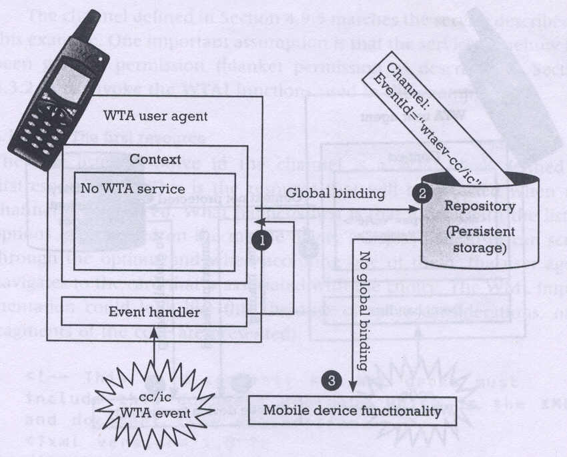
Event Handling (no service in execution)
Source: Heijden

Slide 54
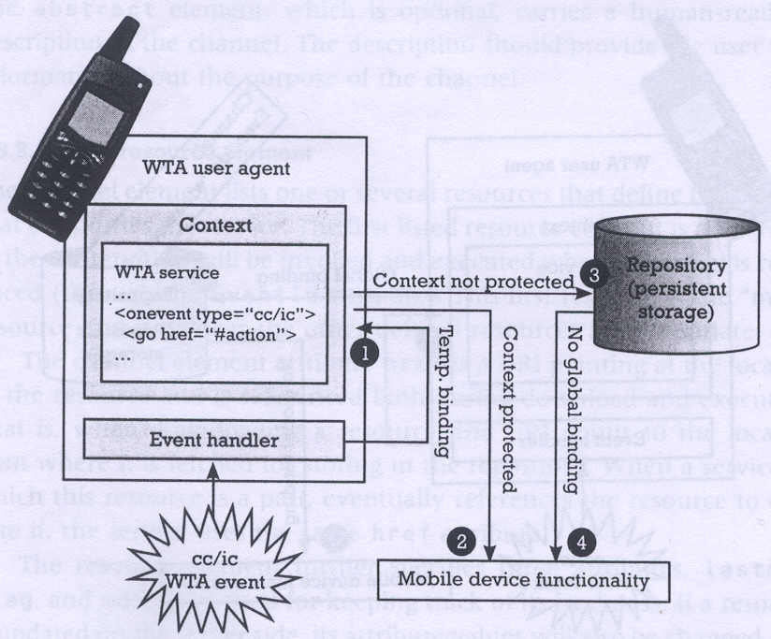
Event Handling (service already execution)
1: Temporary binding exists
2. No temporary binding and context is protected
3: No temporary binding and context is not protected
Source: Heijden

Slide 55
WTA: Voice mail Example
WTA client
WTA server
mobile network
voice mail server
incoming voice
message
indicate new voice message
generate
new deck
push deck
display deck;
user selects
request
wait for call
translate
play requested voice message
setup call
call indication
setup call
accept call
accept call
accept call
voice connection
Source: Schiller

Slide 56
WTA Application: Example (using WML)
<WML>
<CARD>
<DO TYPE="ACCEPT" TASK="GO" URL="#voteChamp"/>
Please vote for your champion!
</CARD>
<CARD NAME="voteChamp">
<DO TYPE="ACCEPT" TASK="GO" URL="wtai://cc/sc;$voteNo;1"/>
Please choose:
<SELECT KEY="voteNo">
<OPTION VALUE="6086415">Mickey</OPTION>
<OPTION VALUE="6086416">Donald</OPTION>
<OPTION VALUE="6086417">Pluto</OPTION>
</SELECT>
</CARD>
</WML>
Source: Schiller

Slide 57
WTA: Example with WML and WMLScript
function voteCall(Nr) {
var j = WTACallControl.setup(Nr,1);
if (j>=0) {
WMLBrowser.setVar("Message", "Called");
WMLBrowser.setVar("No", Nr);
}
else {
WMLBrowser.setVar("Message", "Error!");
WMLBrowser.setVar("No", j);
}
WMLBrowser.go("showResult");
}
Source: Schiller

Slide 58
WTA: Example with WML and WMLScript
<WML>
<CARD>
<DO TYPE="ACCEPT" TASK="GO" URL="#voteChamp"/>
Please vote for your champion!
</CARD>
<CARD NAME="voteChamp">
<DO TYPE="ACCEPT" TASK="GO" URL="/script#voteCall($voteNo)"/>
Please choose:
<SELECT KEY="voteNo">
<OPTION VALUE="6086415">Mickey</OPTION>
<OPTION VALUE="6086416">Donald</OPTION>
<OPTION VALUE="6086417">Pluto</OPTION>
</SELECT>
</CARD>
<CARD NAME="showResult">
Status of your call: $Message $No
</CARD>
</WML>
Source: Schiller

Slide 59
WAP Push Services
Web push
  Scheduled pull by client (browser)
    example: Active Channels
  no real-time alerting/response
    example: stock quotes
Wireless push
  accomplished by using the network itself
    example: SMS
  limited to simple text, cannot be used as starting point for service
    example: if SMS contains news, user cannot request specific news item
WAP push
  Network supported push of WML content
    example: Alerts or service indications
  Pre-caching of data (channels/resources)

Slide 60
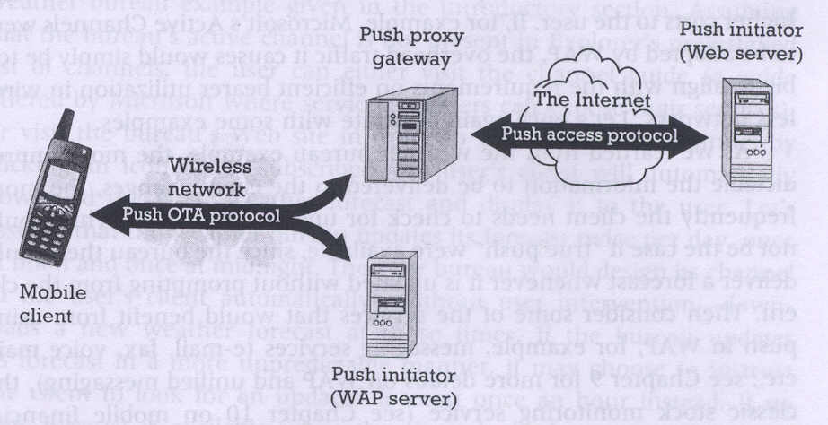
WAP Push Framework
Source: Heijden

Slide 61
Push Access Protocol
Based on request/response model
Push initiator is the client
Push proxy is the server
Initiator uses HTTP POST to send push message to proxy
Initiator sends control information as an XML document, and content for mobile (as WML)
Proxy sends XML entity in response indicating submission status
Initiator can
  cancel previous push
  query status of push
  query status/capabilities of device

Slide 62
Push Proxy Gateway
WAP stack (communication with mobile device)
TCP/IP stack (communication with Internet push initiator)
Proxy layer does
  control information parsing
  content transformation
  session management
  client capabilities
  store and forward
  prioritization
  address resolution
  management function

Slide 63
Over the Air (OTA) Protocol
Extends WSP with push-specific functionality
Application ID uniquely identifies a particular application in the client (referenced as a URI)
Connection-oriented mode
  client informs proxy of application IDs in a session
Connectionless mode
  well known ports, one for secure and other for non-secure push
Session Initiation Application (SIA)
  unconfirmed push from proxy to client
  request to create a session for a specific user agent and bearer

Slide 64
WAE Summary
WML
  analogous to HTML (optimized for wireless)
  event based, microbrowser user agent
WMLScript
  analogous to JavaScript
  features of compiler in the network
WTA
  WTAI: different access rights for different applications/agents
  WTA User Agent (analogy with operating systems)
    Context – Activation Record
    Channel – Interrupt Handler
    Resource – Shared routines invoked by interrupt handlers
    Repository – Library of interrupt handlers
  feature of dynamically pushing the interrupt handler before the event
Push
  no analogy in Internet

Slide 65
WAP Gateway Summary
Encoders
  translate between binary (WML) and text (HTML/WML)
Filters
  transcoding between WML (wireless) and HTML (wired)
Method Proxy
  similar to standard proxy services
  WAP stack on wireless interface and TCP/IP stack on Internet interface
Push Proxy
  Push Access Protocol with Internet Push Initiator (Web Server)
  Over the Air Protocol with mobile device (and WAP Push Initiator)
  Performs necessary filtering, translation etc.

Slide 66
WAP Servers Summary
Origin Server
  Web server with HTML/WML contents
  Runs TCP/IP stack, needs PAP protocol for push, no end-to-end security
WAP Server
  Serves WML content
  Runs WAP stack, uses OTA protocol for push, end-to-end security possible
WTA Server
  Specialized for telephony applications (runs WAP stack, uses push extensively)
  Client initiated (make call “hyperlink” from a Yellow pages service)
  Server intiated (incoming call from a Voice mail service)

Slide 67
WAP: Protocol Stack
Internet
A-SAP
WAP
HTML, Java
Application Layer (WAE)
additional services
and applications
S-SAP
HTTP
Session Layer (WSP)
TR-SAP
Transaction Layer (WTP)
SEC-SAP
SSL/TLS
Security Layer (WTLS)
T-SAP
TCP/IP,
UDP/IP,
media
Transport Layer (WDP)
WCMP
Bearers (GSM, CDPD, ...)
WAE comprises WML (Wireless Markup Language), WML Script, WTAI etc.
Source: Schiller

Slide 68
WDP: Wireless Datagram Protocol
Goals
  create a worldwide interoperable transport system by adapting WDP to the different underlying technologies
  transmission services, such as SMS in GSM might change, new services can replace the old ones
WDP
  Transport layer protocol within the WAP architecture
  uses the Service Primitive
    T-UnitData.req .ind
  uses transport mechanisms of different bearer technologies
  offers a common interface for higher layer protocols
  allows for transparent communication despite different technologies
  addressing uses port numbers
  WDP over IP is UDP/IP

Slide 69
WDP: Service Primitives
T-SAP
T-SAP
T-DUnitdata.req
(DA, DP, SA, SP, UD)
T-DUnitdata.ind
(SA, SP, UD)
T-DUnitdata.req
(DA, DP, SA, SP, UD)
T-DError.ind
(EC)
SAP: Service Access Point
DA: Destination Address
DP: Destination Port
SA: Source Address
SP: Source Port
UD: User Data
EC: Error Code
Source: Schiller

Slide 70
Service, Protocol, and Bearer Example
WAP Over GSM Circuit-Switched
Mobile
WAP Proxy/Server
WAE
WAE
Apps on
Other Servers
WSP
ISP/RAS
WSP
IWF
WTP
WTP
UDP
UDP
IP
IP
IP
PPP
PPP
Subnetwork
Subnetwork
CSD-RF
CSD-RF
PSTN
Circuit
PSTN
Circuit
RAS - Remote Access Server
IWF - InterWorking Function
Source: WAP Forum
Notes:
Any bearer which supports IP will be able to support WTP since WTP/T and in future WTP/C is defined for operation over UDP. The WTP/D service is UDP/IP.
Note: UDP will require a new port number to be issued/reserved by IANA for WAP. After which the suite of WAP protocols will be distinguished by port numbers or protocol identifiers defined by the WAP Forum within the WAP UDP port number issued by IANA.

Slide 71
Service, Protocol, and Bearer Example
WAP Over GSM Short Message Service
WAP Proxy/Server
Mobile
WAE
WAE
Apps on
other servers
WSP
WSP
WTP
SMSC
WTP
WDP
WDP
SMS
SMS
WDP Tunnel Protocol
WDP Tunnel
Protocol
Subnetwork
Subnetwork
under development
Source: WAP Forum

Slide 72
WTLS:Wireless Transport Layer Security
Goals
  Provide mechanisms for secure transfer of content, for applications needing privacy, identification, message integrity and non-repudiation
  Provide support for protection against denial-of-service attacks
WTLS
  is based on the TLS/SSL (Transport Layer Security) protocol
  optimized for low-bandwidth communication channels
  provides
    privacy (encryption)
    data integrity (MACs)
    authentication (public-key and symmetric)
  Employs special adapted mechanisms for wireless usage
    Long lived secure sessions
    Optimised handshake procedures
    Provides simple data reliability for operation over datagram bearers

Slide 73
WTLS Internal Architecture
Transaction Protocol (WTP)
Handshake Protocol
Alert Protocol
Application Protocol
Change Cipher Spec Protocol
WTLS
Record Protocol
Record protocol
Datagram Protocol (WDP/UDP)
Bearer networks
Source: WAP Forum
Notes:
Note to translator:
Here I am going to explain and talk about each of the protocol elements in the WTLS layer

Slide 74
WTLS: Secure session, Full handshake
originator
SEC-SAP
peer
SEC-SAP
SEC-Create.req
(SA, SP, DA, DP, KES, CS, CM)
SEC-Create.ind
(SA, SP, DA, DP, KES, CS, CM)
SEC-Create.res
(SNM, KR, SID, KES‘, CS‘, CM‘)
SEC-Create.cnf
(SNM, KR, SID, KES‘, CS‘, CM‘)
SEC-Exchange.req
KES: Key Exchange Suite
CS: Cipher Suite
CM: Compression Mode
SNM: Sequence Number Mode
KR: Key Refresh Cycle
SID: Session Identifier
CC: Client Certificate
SEC-Exchange.ind
SEC-Exchange.res
(CC)
SEC-Commit.req
SEC-Exchange.cnf
(CC)
SEC-Commit.ind
SEC-Commit.cnf
Source: Schiller

Slide 75
WTLS: Transferring Datagrams
sender
SEC-SAP
receiver
SEC-SAP
SEC-Unitdata.req
(SA, SP, DA, DP, UD)
SEC-Unitdata.ind
(SA, SP, DA, DP, UD)
Source: Schiller

Slide 76
WTP: Wireless Transaction Protocol
Goals
  different transaction services that enable applications to select reliability, efficiency levels
  low memory requirements, suited to simple devices (< 10kbyte )
  efficiency for wireless transmission
WTP
  supports peer-to-peer, client/server and multicast applications
  efficient for wireless transmission
  support for different communication scenarios
  class 0: unreliable message transfer
    unconfirmed Invoke message with no Result message
    a datagram that can be sent within the context of an existing Session
  class 1: reliable message transfer without result message
    confirmed Invoke message with no Result message
    used for data push, where no response from the destination is expected
  class 2: reliable message transfer with exactly one reliable result message
    confirmed Invoke message with one confirmed Result message
    a single request produces a single reply

Slide 77
WTP Services and Protocols
WTP (Transaction)
  provides reliable data transfer based on request/reply paradigm
    no explicit connection setup or tear down
    optimized setup (data carried in first packet of protocol exchange)
    seeks to reduce 3-way handshake on initial request
  supports
    header compression
    segmentation /re-assembly
    retransmission of lost packets
    selective-retransmission
    port number addressing (UDP ports numbers)
    flow control
  message oriented (not stream)
  supports an Abort function for outstanding requests
  supports concatenation of PDUs
  supports User acknowledgement or Stack acknowledgement option
    acks may be forced from the WTP user (upper layer)
    default is stack ack
Notes:
Since there is no connection setup phase there is no mechanism to negotiate parameters (actually some things can be negotiated but not in the full sense that a connection-oriented call setup would allow) to be used during the message exchange, such as packet size or window size (packet group). Therefore using WTP/T requires an a priori agreement between the mobile and server as to the default parameters to be used during a message exchange.
Packet versus Streams
-a packet interface allows the application more control over a partial transmission. It requires the application (Session layer) to segment its transmission data to fixed length packets, this allows the restarting of a failed transmission at the place of the last successful transmission - checkpointing.
-a stream interface is what is most commonly implemented for TCP (sockets) and is widely used by TCP applications.

Slide 78
WTP Services and Protocols
uses the service primitives
  T-TRInvoke.req .cnf. .ind .res
  T-TRResult.req .cnf .ind .res
  T-Abort.req .ind
Client
(PDUs)
Server
T-TRInvoke.req
Invoke
T-TRInvoke.ind
T-TRInvoke.cnf
Ack
T-TRInvoke.res
Result
T-TRResult.ind
T-TRResult.req
T-TRResult.res
Ack
T-TRResult.cnf
Notes:
Ack may be piggybacked on a Result packet, therefore the Ack is shown with a dotted line.

Slide 79
WTP Class 0 Transaction
initiator
TR-SAP
responder
TR-SAP
TR-Invoke.req
(SA, SP, DA, DP, A, UD, C=0, H)
TR-Invoke.ind
(SA, SP, DA, DP, A, UD, C=0, H‘)
Invoke PDU
A: Acknowledgement Type (WTP/User)
C: Class (0,1,2)
H: Handle (socket alias)
Source: Schiller

Slide 80
WTP Class 1 Transaction, no user ack & user ack
initiator
TR-SAP
responder
TR-SAP
TR-Invoke.req
(SA, SP, DA, DP, A, UD, C=1, H)
TR-Invoke.ind
(SA, SP, DA, DP, A, UD, C=1, H‘)
Invoke PDU
TR-Invoke.cnf
(H)
Ack PDU
initiator
TR-SAP
responder
TR-SAP
TR-Invoke.req
(SA, SP, DA, DP, A, UD, C=1, H)
TR-Invoke.ind
(SA, SP, DA, DP, A, UD, C=1, H‘)
Invoke PDU
TR-Invoke.res
(H‘)
TR-Invoke.cnf
(H)
Ack PDU
Source: Schiller

Slide 81
WTP Class 2 Transaction, no user ack, no hold on
initiator
TR-SAP
responder
TR-SAP
TR-Invoke.req
(SA, SP, DA, DP, A, UD, C=2, H)
TR-Invoke.ind
(SA, SP, DA, DP, A, UD, C=2, H‘)
Invoke PDU
TR-Result.req
(UD*, H‘)
TR-Invoke.cnf
(H)
Result PDU
TR-Result.ind
(UD*, H)
TR-Result.res
(H)
Ack PDU
TR-Result.cnf
(H‘)
Source: Schiller

Slide 82
WTP Class 2 Transaction, user ack
initiator
TR-SAP
responder
TR-SAP
TR-Invoke.req
(SA, SP, DA, DP, A, UD, C=2, H)
TR-Invoke.ind
(SA, SP, DA, DP, A, UD, C=2, H‘)
Invoke PDU
TR-Invoke.res
(H‘)
TR-Invoke.cnf
(H)
Ack PDU
TR-Result.req
(UD*, H‘)
TR-Result.ind
(UD*, H)
Result PDU
TR-Result.res
(H)
Ack PDU
TR-Result.cnf
(H‘)
Source: Schiller

Slide 83
WTP Class 2 Transaction, hold on, no user ack
initiator
TR-SAP
responder
TR-SAP
TR-Invoke.req
(SA, SP, DA, DP, A, UD, C=2, H)
TR-Invoke.ind
(SA, SP, DA, DP, A, UD, C=2, H‘)
Invoke PDU
TR-Invoke.cnf
(H)
Ack PDU
TR-Result.req
(UD*, H‘)
TR-Result.ind
(UD*, H)
Result PDU
TR-Result.res
(H)
Ack PDU
TR-Result.cnf
(H‘)
Source: Schiller

Slide 84
WSP - Wireless Session Protocol
Goals
  HTTP 1.1 functionality
    Request/reply, content type negotiation, ...
  support of client/server transactions, push technology
  key management, authentication, Internet security services
WSP Services
  provides shared state between client and server, optimizes content transfer
  session management (establish, release, suspend, resume)
  efficient capability negotiation
  content encoding
  push
WSP/B (Browsing)
  HTTP/1.1 functionality - but binary encoded
  exchange of session headers
  push and pull data transfer
  asynchronous requests

Slide 85
HTTP 1.1 and WSP
HTTP 1.1
  extensible request/reply methods
  extensible request/reply headers
  content typing
  composite objects
  asynchronous requests
WSP enhancements beyond HTTP
  binary header encoding
  session headers
  confirmed and non-confirmed data push
  capability negotiation
  suspend and resume
  fully asynchronous requests
  connectionless service
Why Not HTTP?
  encoding not compact enough, inefficient capability negotiation
  no push facility

Slide 86
WSP Overview
Header Encoding
  compact binary encoding of headers, content type identifiers and other well-known textual or structured values
  reduces the data actually sent over the network
Capabilities (are defined for):
  message size, client and server
  protocol options: Confirmed Push Facility, Push Facility, Session Suspend Facility, Acknowledgement headers
  maximum outstanding requests
  extended methods
  header code pages
Suspend and Resume
  server knows when client can accept a push
  multi-bearer devices
  dynamic addressing
  allows the release of underlying bearer resources

Slide 87
WSP Sessions
Session Context and Push
  push can take advantage of session headers
  server knows when client can accept a push
Connection-mode
  long-lived communication, benefits of the session state, reliability
Connectionless-mode
  stateless applications, no session creation overhead, no reliability overhead

Slide 88
WSP/B session establishment
client
S-SAP
server
S-SAP
S-Connect.req
(SA, CA, CH, RC)
Connect PDU
S-Connect.ind
(SA, CA, CH, RC)
S-Connect.res
(SH, NC)
S-Connect.cnf
(SH, NC)
ConnReply PDU
CH: Client Header
RC: Requested Capabilities
SH: Server Header
NC: Negotiated Capabilities
WTP Class 2
transaction
Source: Schiller

Slide 89
WSP/B session suspend/resume
client
S-SAP
server
S-SAP
S-Suspend.req
S-Suspend.ind
(R)
Suspend PDU
S-Suspend.ind
(R)
WTP Class 0
transaction
~
~
R: Reason for disconnection
S-Resume.req
(SA, CA)
Resume PDU
S-Resume.ind
(SA, CA)
S-Resume.res
Reply PDU
S-Resume.cnf
WTP Class 2
transaction
Source: Schiller

Slide 90
WSP/B session termination
client
S-SAP
server
S-SAP
S-Disconnect.req
(R)
S-Disconnect.ind
(R)
Disconnect PDU
S-Disconnect.ind
(R)
WTP Class 0
transaction
Source: Schiller

Slide 91
WSP/B method invoke
client
S-SAP
server
S-SAP
S-MethodInvoke.req
(CTID, M, RU)
Method PDU
S-MethodInvoke.ind
(STID, M, RU)
S-MethodInvoke.res
(STID)
S-MethodInvoke.cnf
(CTID)
S-MethodResult.req
(STID, S, RH, RB)
S-MethodResult.ind
(CTID, S, RH, RB)
Reply PDU
S-MethodResult.res
(CTID)
S-MethodResult.cnf
(STID)
CTID: Client Transaction ID
M: Method Invoked
RU: Request URI
STID: Server Transaction ID
S: Response Status
RH: Response Header
RB: Response Body
WTP Class 2
transaction
Source: Schiller

Slide 92
WSP/B over WTP - method invocation
client
S-SAP
initiator
TR-SAP
responder
TR-SAP
server
S-SAP
S-MethodInvoke.req
TR-Invoke.req
Invoke(Method)
TR-Invoke.ind
S-MethodInvoke.ind
TR-Invoke.res
S-MethodInvoke.res
Ack PDU
S-MethodInvoke.cnf
TR-Invoke.cnf
TR-Result.req
S-MethodResult.req
Result(Reply)
S-MethodResult.ind
TR-Result.ind
S-MethodResult.res
TR-Result.res
Ack PDU
TR-Result.cnf
S-MethodResult.cnf
Source: Schiller

Slide 93
WSP/B over WTP - asynchronous, unordered requests
client
S-SAP
server
S-SAP
S-MethodInvoke_1.req
S-MethodInvoke_2.req
S-MethodInvoke_2.ind
S-MethodInvoke_1.ind
S-MethodInvoke_3.req
S-MethodResult_1.req
S-MethodInvoke_3.ind
S-MethodResult_1.ind
S-MethodResult_3.req
S-MethodResult_3.ind
S-MethodResult_2.req
S-MethodInvoke_4.req
S-MethodInvoke_4.ind
S-MethodResult_4.ind
S-MethodResult_4.req
S-MethodResult_2.ind
Source: Schiller

Slide 94
WSP/B - confirmed/non-confirmed push
client
S-SAP
server
S-SAP
S-Push.req
(PH, PB)
S-Push.ind
(PH, PB)
Push PDU
WTP Class 0
transaction
PH: Push Header
PB: Push Body
SPID: Server Push ID
CPID: Client Push ID
client
S-SAP
server
S-SAP
S-ConfirmedPush.req
(SPID, PH, PB)
S-ConfirmedPush.ind
(CPID, PH, PB)
ConfPush PDU
S-ConfirmedPush.res
(CPID)
S-ConfirmedPush.cnf
(SPID)
WTP Class 1
transaction
Source: Schiller

Slide 95
WSP/B over WDP
client
S-SAP
server
S-SAP
S-Unit-MethodInvoke.req
(SA, CA, TID, M, RU)
Method PDU
S-Unit-MethodInvoke.ind
(SA, CA, TID, M, RU)
S-Unit-MethodResult.req
(CA, SA, TID, S, RH, RB)
S-Unit-MethodResult.ind
(CA, SA, TID, S, RH, RB)
Reply PDU
S-Unit-Push.req
(CA, SA, PID, PH, PB)
S-Unit-Push.ind
(CA, SA, PID, PH, PB)
Push PDU
WDP Unitdata
service
Source: Schiller

Slide 96
WAP Stack Summary
WDP
  functionality similar to UDP in IP networks
WTLS
  functionality similar to SSL/TLS (optimized for wireless)
WTP
  Class 0: analogous to UDP
  Class 1: analogous to TCP (without connection setup overheads)
  Class 2: analogous to RPC (optimized for wireless)
  features of “user acknowledgement”, “hold on”
WSP
  WSP/B: analogous to http 1.1 (add features of suspend/resume)
  method: analogous to RPC/RMI
  features of asynchronous invocations, push (confirmed/unconfirmed)

Slide 97
WAP: Ongoing Work
WDP
  Tunnel to support WAP where no (end-to-end) IP bearer available
WTLS
  support for end-to-end security (extending WTLS endpoint beyond WAP Gateway)
  interoperable between WAP and Internet (public key infrastructure)
  integrating Smart Cards for security functions
WTP
  efficient transport over wireless links (wireless TCP)
  bearer selection/switching
  quality of service definitions
WSP
  quality of service parameters
  multicast data, multimedia support
WAE
  User agent profiles: personalize for device characteristics, preferences etc
  Push architecture, asynchronous applications
  Billing

Slide 98
WAP: Hype vs Reality
Low-bandwidth wireless links
  tcp/ip over wireless can also address these problems
  encoding in http can also reduce data transfer on wireless links
Limited device capabilities
  Microbrowser is appropriate to address this problem
  WTAI features are not present in tcp/ip domain
Challenges in WAP
  adapting to applications rich in content and interaction
  service guarantees
  interface design and usability
Other approaches for WWW access through mobiles
  i-Mode (from NTT DoCoMo)
  WAP is a TRAP (http://www.freeprotocols.org/wapTrap)

Slide 99
References and Resources
Books
  Mobile communications: Jochen Schiller, Addison Wesley 2000
  Understanding WAP:
Official Website (specifications)
  www.wapforum.org
Technical/Developer Info and tools
  www.palopt.com.au/wap
  www.wap.net
Major players
  www.nokia.com/wap
  www.ericsson.se/wap
  phone.com
OpenSource effort
  www.wapgateway.org (Kannel WAP gateway project)

Slide 100
Thank You
This presentation is available online from
http://www.it.iitb.ernet.in/~sri/talks
Sridhar Iyer
KR School of Information Technology
IIT Bombay

